Slide 1
California Adolescent Literacy Initiative (CALI) Reads
A State Personnel Development Grant (SPDG)
Applicant Informational Webinar
Vicki Griffo, PhD
Project Director
September 2018
Contact us at info@calireads.org
Notes:
Hello and welcome to today’s Application Informational Webinar for the CALI Reads Project.
I’ll begin with introductions: I’m Vicki Griffo, the CALI Project Director. Also on the line is Sarah Hughes the Project Manager, and Melina Boyd, the Project Coordinator.
In today’s call I’m going to go through a few slides that describe the project and highlight key pieces of the application. I think it will take me about 15 mins to get through the slides and then we have reserved the rest of the time for questions. We have quite a few people on this call, so I ask a couple of things from you:
1. Please hold your questions until I’m through the slides, and
2. Please use the comment feature of Adobe Connect to submit your question so that we are not all talking over each other.
If you leave today’s call, with unanswered or additional questions, please email us at info@calireads.org and we will respond in writing, or reserve time for an additional conversation.

Slide 2
What’s the Purpose of this Webinar?
To give information and insight into this 5 year OSEP project
To clarify project expectations and activities
To help potential applicants decide if this is a good fit and whether to apply
To address questions related to the Request for Applications
Notes:
The primary purpose of our webinar today is to provide information and insight into this 5-year OSEP project so that you can decide whether this project sounds like a good fit for your district, county office, or consortium and better determine if you’d like to proceed with your application.
As a sidenote, if you are joining this call as a coach who is interested in applying to work with the sites and district, you will likely gain valuable information from this call, but today’s webinar will not specifically focus on the coach role and responsibilities. Instead, we will hold a subsequent Webinar for potential coaches following the request for coach applications in early fall.

Slide 3
Who Are We?
Office Of Special Education Projects (OSEP)
California Department of Education (CDE)
Napa County Office of Education (NCOE)
Satellite Office in Petaluma (NCOE - Petaluma)
Notes:
CALI Reads is a State Personnel Development Grant (spdg) funded by the Office of Special Education Projects. This Spdg was competitively awarded to the California Department of Education (CDE). It is administered under CDE’s guidance through Napa County Office of Education. We are housed in a satellite office in Petaluma. On site, there are several statewide Special Education projects who run out of NCOE. And, in fact, our teams have been doing this kind of work for over 20 years.

Slide 4
What are CALI Reads’ goals?
To increase teacher use of evidence-based literacy practices in word study, vocabulary, and comprehension across content area instruction.
To sustain and disseminate evidence-based literacy strategies and practices.
To increase the implementation of multi-tiered systems of support through appropriate student identification, instruction, and data-based decision making.
To improve English language arts and reading outcomes for all students, and particularly students with disabilities.
…In California districts and middle schools
Notes:
Our project has the following four main goals…

Slide 5
Who is Eligible to Apply?
All California Districts are invited to apply. Applicants will be evaluated based on the following eligibility criteria, and prioritized accordingly:
Need — Ranks as Red, Orange, or Yellow on the CDE Dashboard in ELA Performance for all students and students with disabilities;
Readiness — Demonstrates a focus on school-wide literacy and support of student with disabilities, and shows evidence of district-wide collaboration and leadership, data decision-making, inclusive programming and tiered systems of support.
Notes:
All California districts are welcome to apply, but applicants will be evaluated based on the criteria NEED and READINESS.
Need
Our selection will prioritize districts and their school sites in high NEED which means that they rank as RED, ORANGE, and YELLOW on the CDE dashboard in English language arts.
Readiness
We are looking for Districts and middle schools who demonstrate a reasonable level of READINESS. When we say reasonable level, we mean that the best applicants are districts/sites who’ve done some preliminary work.

Slide 6
Who is a Good Fit for the Project?
Applicants who:
1. Have a strong commitment to improving literacy outcomes.
2. Have a strong commitment to students with disabilities.
3. Can commit to all 5 years of the project.
4. Find alignment in project activities and expectations with their district/site goals, priorities, and other initiatives.
5. Have Identified district and site leaders to guide, support, and lead project participation and activities.
6. Have identified three or more eligible middle schools or have formed consortium with another district in need.

Slide 7
The Structure of CALI Reads Coaching

Slide 8
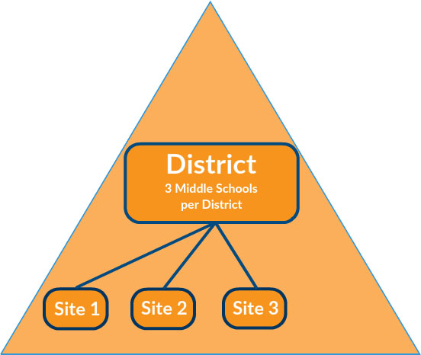

District and Site Breakdown
Site 4
will be added in Year 4 & 5

Slide 9


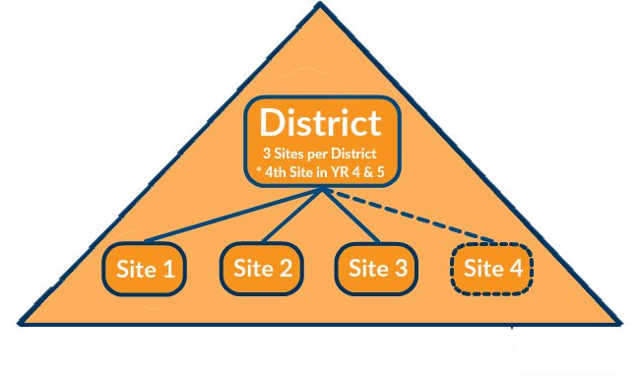
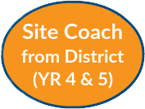

Regional and Site Support

Slide 10
GEOGRAPHICAL REGION
**The Regional Coach Supports 3 Districts**
1
2
3

Slide 11

Northern Region
1
2
3
Central Region
1
2
3
Southern Region
1
2
3

Slide 12
Application Information

Slide 13
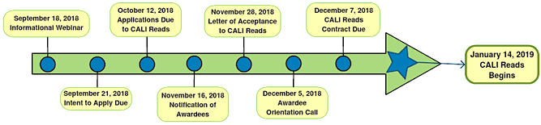
What is the Application Process and Timeline?
Submit an Intent to Apply by September 21st, 2018
Cover Sheet (1 page)
Contact and Demographic Information (2 pages)
Submit a CALI Reads Application by October 12th, 2018.
Contact and Demographic Information
District Narrative
Site Narrative (completed by each site)
Notes:
Intent to apply is optional, but we greatly appreciate your submission. And, I’ll talk more about that in the next slide.

Slide 14
What are the Intent to Apply Materials?
Identifies:
Whether applying as a District and/or Consortium or requesting help in identifying a consortium partner
District Lead Contact (project point person)
District Fiscal Contact (contracts and invoices)
3 qualifying middle schools, demographic info, and lead administrator
Notes:
The Intent to Apply is a quick, 3 page, fill in the blank document.
It asks you to identify the following:
Intention to apply as a District or Consortium (or request for help in identifying a consortium partner).
District Lead contract who will serve as project point person.
Fiscal lead who will handle contracts and invoicing.
Name 3 qualifying middle schools, demographic info, and lead administrator.

Slide 15
What are the Application Materials?
1. District and Site Contact and Demographic Information
2. Written narrative on five questions:
District Level Qs
Alignment and Fit
Special Education Approach and Program
Site Level Qs
English Language Arts/Reading Program
Leadership Teams Communication and Collaboration
Data-based Decision Making
Notes:
Note:
We do not expect that applicants are excelling in these categories. Rather, we gauge readiness by looking for applicants who demonstrate evidence of building some infrastructure and having done some preliminary work in these areas. In your application, it’s a good opportunity to express where your district thinking currently is, what you’ve tried, successes and failures. Those honest discussions will better inform us on how the CALI Reads project can best support your district goals, priorities, and direction.

Slide 16
Application Narrative Scoring Criteria
District Readiness will be evaluated using the following five Criteria:
Demonstration of need and readiness for project implementation (as evidenced by alignment to other district priorities, the LCAP plan, and current initiatives at district and site level).
Demonstrated approach to inclusive education, individualized programming, and collaboration across service professionals and families.
Demonstrated use of data-based decision making (as evidenced by academic data collection and analysis used to guide student support and services).
Demonstrated application of tiered systems of support (as evidenced by identified interventions, how students are identified for extra support(s), and teacher training).
Demonstration of district and site leadership focused on literacy and/or students with disabilities.
Notes:
In the Application packet, we’ve also included the Narrative Scoring Criteria which gives you a general idea of what we are reading for.

Slide 17
Overview of Participant Commitments

Slide 18
What are Districts Expected to do?
Choose a district representative
Identify a fiscal lead
Collaborate with a CALI Regional Coach
Form a District Support Team (DST) and leader
Host a One-Day Regional Workshop (facilitated by CALI)
Encourage participation
Leverage project funds appropriately
Distribute project funds for teacher release time or extended time for CALI activities
Notes:
Overview of Participant Commitments
Districts funded under this project are expected to:
Designate a district representative
Identify a fiscal contact for contracting and invoicing
Commit to meeting and collaborating with a CALI Regional Coach
Form a District Support Team (DST) attended by district and site participants bi-annually
Designate a district representative to lead the DST
Ensure project funds are being leveraged appropriately
Distribute designated project funds for teacher release time or extended time for CALI activities
Host a One-Day Regional Workshop (facilitated by CALI) at the district office
Encourage participant attendance at the One-Day Regional Workshop
Teachers participating on the project are expected to:
Commit to meeting, training, and collaboration with a CALI-trained Site Coach
Participate in literacy training through online modules
Apply CALI training in the classroom and monitor implementation
Participate in the Site Implementation Team and/or Teacher Support Team
Attend a Regional Workshop
Participate in periodic data collection

Slide 19
What are Sites Expected to do?
Identify participants
Form and attend leadership teams
Leverage project funds appropriately: to support team meetings, collaboration, and training
Collaborate with the CALI Site Coach
Attend the Regional Workshop
Host an Annual Family Workshop
Collaborate with a Parent Training Information Center
Participate in periodic data collection
Notes:
Sites funded under this project are expected to:
Select at minimum 10 site administrators and teacher participants across content areas
Select at minimum 6 Special Education and Intervention teacher participants
Designate project participants as representatives on the District Support Team, Site Implementation Team and Teacher Support Teams
Leverage project funds to support team meetings, collaboration, and training
Collaborate with the CALI Site Coach
Identify participants to attend the Regional Workshop
Host an Annual Family Workshop
Collaborate with a Parent Training Information Center

Slide 20
Benefits to District and Site Participation

Slide 21
Direct Funds for the Support of District Participation
Support District Participation | 2018-19 | 2019-20 | 2020-21 | 2021-22 | 2022-23
District Support Team (DST) | $3,000 total $1,000 per site | $3,000 total $1,000 per site | $3,000 total $1,000 per site | $3,000 total $1,000 per site | $3,000 total $1,000 per site
Host One Day Regional Workshop | $1,500 | $1,500 | $1,500 | $1,500 | $1,500
Subtotal for District Funds to support District Participation | $4,500 | $4,500 | $4,500 | $4,500 | $4,500

Slide 22
Direct Funds for the Support of District Participation Description of Funds
* District Support Team (DST)
Description: Grant funds are to support the District Support Team (DST) participation in bi-annual meetings.
The DST will hold bi-annual meetings to address policy, practice, and fiscal matters that will better facilitate Site level implementation of the CALI program. DSTs are formed by both two to three participants at the:
a) District level in roles such as the Director of Curriculum & Instruction, Director of Special Education, Director of Ed Services, District Literacy Coach, and
b) Middle School Site level in roles of Lead Admin, resource, and/or teachers.
* Hosting Regional Workshop
Description: Funds are to support District efforts to host the annual workshop at a District Office (or suitable location).

Slide 23
Direct Funds for the Support of Site Participation
Support Site Participation | 2018-19 | 2019-20 | 2020-21 | 2021-22 | 2022-23
Site Implementation Team (SIT) | n/a | $2400 total $800 per site | $2400 total $800 per site | $2400 total $800 per site | $2400 total $800 per site
One-Day Regional Workshop Participation | $3000 total $1000 per site | $3000 total $1000 per site | $3000 total $1000 per site | $1,350 additional site only | $1,350 additional site only
Teacher Participation | $22,500 total $7,500 per site | $27,000 total $9,000 per site | $27,000 total $9,000 per site | $27,000 total $9,000 per site + $2,700 additional site | $27,000 total $9,000 per site + $2,700 additional site
Coaching for Special Education & Intervention Teachers | n/a | $5,400 total $1,800 per site | $5,400 total $1,800 per site | $2700 total $900 per site | $2700 total $900 per site
Parent Workshop Funds | n/a | $1500 total $500 per site | $1500 total $500 per site | $1500 total $500per site | $1500 total $500 per site
Subtotal for District Funds to support Site Participation | $25,500 total | $39,300 total | $39,300 total | $37,650 total | $37,650 total

Slide 24
Direct Funds for the Support of Site Participation Description of Funds
* Site Implementation Team (SIT)
Description: Funds to support participation in SIT and leadership trainings.
Year 1: Sufficient funds to support 5 staff for 10 days at $150.
Year 2-5: Sufficient funds to support 4 staff at 4 meetings/year.
* One Day Regional Workshop Participation
Description: Funds are to support up to five SIT team members from each middle school. Attend one-day Regional Workshop.
Year 1: funds support 5 SIT team members.
Year 2 & 3: funds support 6 Special Education/Intervention Teachers to participate.
Year 4 & 5: funds support 9 new teachers from additional middle school.
* Teacher Participation Funds
Description: Funds are to support ~10 days of teacher release time per middle school team for participation in CALI Reads activities. Participation includes coaching time with the site coach, collaborating with fellow teachers, attending trainings, and attending SIT meetings.
Year 1: funds support 5 staff for up to 10 days at $150/day of release + extended time to meet with Site Coach and colleagues.
Year 2-5: funds support 15 staff for 4 days at $150/day.
Year 4 & 5: additional funds support 9 staff for 2 days at $150/day at district’s additional middle school.
* Coaching for Special Education and Intervention Teachers
Year 2 & 3: funds support 6 teachers for additional 2 days of PD.
Year 4 & 5: funds support 6 teachers for additional 1 day of PD.
* Parent Workshop Funds
Description: Funds are to support the middle school hosting an annual Parent Workshop.

Slide 25
Goods and Services
Goods and Services | 2018-19 | 2019-20 | 2020-21 | 2021-22 | 2022-23
One Regional Coach | ✓ | ✓ | ✓ | ✓ | ✓
Three Site Coaches | ✓ | ✓ | ✓ | ✓ | ✓
A Set of ~25 high-interest, low-level readers | ✓ | ✓ | ✓ | Additional site only | Additional site only
iPads and stand | ✓ | n/a | n/a | n/a | n/a
Wi-Fi Stipends | As needed | As needed | As needed | As needed | As needed
Literacy and Systems Materials, Videos, Modules | n/a | ✓ | ✓ | ✓ | ✓
Assessment Menu of resource materials | n/a | ✓ | ✓ | ✓ | ✓
Sponsor of a Parent Training Information (PTI) partner | ✓ | ✓ | ✓ | ✓ | ✓

Slide 26
Goods and Services Description of Funds
* A Regional Coach
Description: One Regional Coach will be assigned to each district. The Regional Coach will offer:
~5 days coaching, and
b) support at the annual Regional Workshop. Regional Coaches are trained by Literacy Experts from Institutes of Higher Education.
* Three Site Coaches
Description: One site coach will be assigned to each of the District’s participating middle schools. The Site Coach will offer:
~3 days of coaching/training per middle school, and
b) support at the annual Regional Workshop. Site Coaches are trained by Literacy Experts from Institutes of Higher Education.
*High-interest, low-level classroom book sets.
Description: A classroom set of ~25 high-interest, low-level readers will be selected for each middle school.
* iPads
Description: iPads will be provided to support the work of coaches, site, and key staff and ensure flexible access to online materials & training.
* Wi-Fi Stipends
Offered by request to sites with limited Wi-Fi to support cellular access.
* Literacy and Systems Materials, Videos, Modules
Description: Developed materials will support teacher and administrator professional growth.
* Assessment Menu
Description: Menu of resource materials to support multi-tiered literacy systems and support collaborative data planning process.
*Parent Training Information (PTI) Center partner
Description: PTI Center’s within the respective region will collaborate and facilitate family involvement at the school site and develop materials.

Slide 27
Questions?
Contact us at info@calireads.org

Slide 28
Thank you for attending!
We look forward to your applications.

